Slide 1
EV charger scheduling scheme
Instructor: Michael Ferris
Student: Zhengwei Tong

Slide 2
Simulation Flow
Data Generation
Choice Model
Parking Simulation
Notes:
All making same choice, therefore all drivers will swarm into the same parking lots (if the choice_utility only use price and distance)

Slide 3



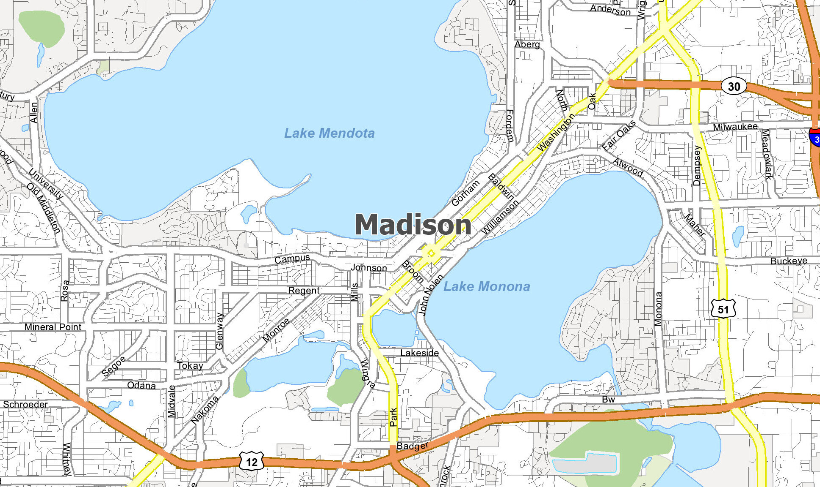


Data Generation – Initial Data Generation
Initial Data Generation
Notes:
All making same choice, therefore all drivers will swarm into the same parking lots (if the choice_utility only use price and distance)

Slide 4
Data Generation – Initial Data Generation
Price
Spots
Choice
Distance
Initial Data Generation
Arrival
Inflow
Notes:
All making same choice, therefore all drivers will swarm into the same parking lots (if the choice_utility only use price and distance)

Slide 5
Data Generation – Initial Data Generation
Price
Random
Uniform Distribution on given range
Fixed
Distance
Random
Uniform Distribution on given range
Fixed
Spots
Enumeration
Arrival
Random
Uniform Distribution on given range
Ascending
Initial Data Generation
Notes:
All making same choice, therefore all drivers will swarm into the same parking lots (if the choice_utility only use price and distance)

Slide 6
Data Generation – Initial Data Generation
 | Price |  |  |  | Spots |  |  |  | Distance |  |  |  | Arrival
Drivers
Initial Data Generation
Notes:
All making same choice, therefore all drivers will swarm into the same parking lots (if the choice_utility only use price and distance)

Slide 7
Simulation Flow
Data Generation
Choice Model
Parking Simulation
Notes:
All making same choice, therefore all drivers will swarm into the same parking lots (if the choice_utility only use price and distance)

Slide 8
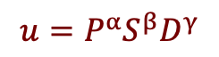
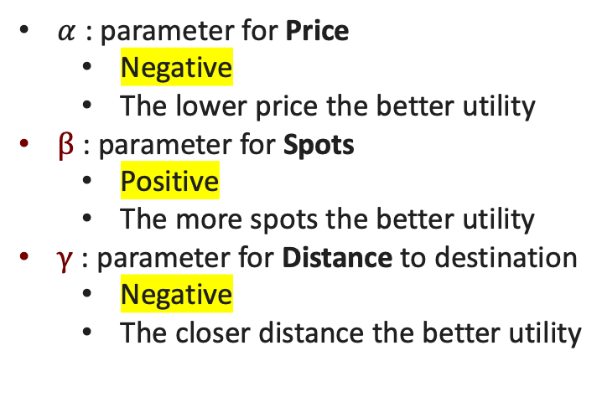
Choice Model - Cobb-Douglas Function
Price
Spots
Choice
Distance
Choice Model
$α$ : parameter for Price
Negative
The lower price the better utility
$β$ : parameter for Spots
Positive
The more spots the better utility
$γ$ : parameter for Distance to destination
Negative
The closer distance the better utility
MAX UTILITY
$$u=P^{α}S^{β}D^{γ}$$
Notes:
All making same choice, therefore all drivers will swarm into the same parking lots (if the choice_utility only use price and distance)

Slide 9
Choice Model - Cobb-Douglas Function
 | Price |  |  |  | Spots |  |  |  | Distance |  |  |  | Arrival |  |  |  | Choice
Drivers
Choice Model
Notes:
All making same choice, therefore all drivers will swarm into the same parking lots (if the choice_utility only use price and distance)

Slide 10
Simulation Flow
Data Generation
Choice Model
Parking Simulation
Notes:
All making same choice, therefore all drivers will swarm into the same parking lots (if the choice_utility only use price and distance)

Slide 11
Parking Simulation
Inflow Simulation
Parking Simulation
Lots Simulation
Notes:
All making same choice, therefore all drivers will swarm into the same parking lots (if the choice_utility only use price and distance)

Slide 12
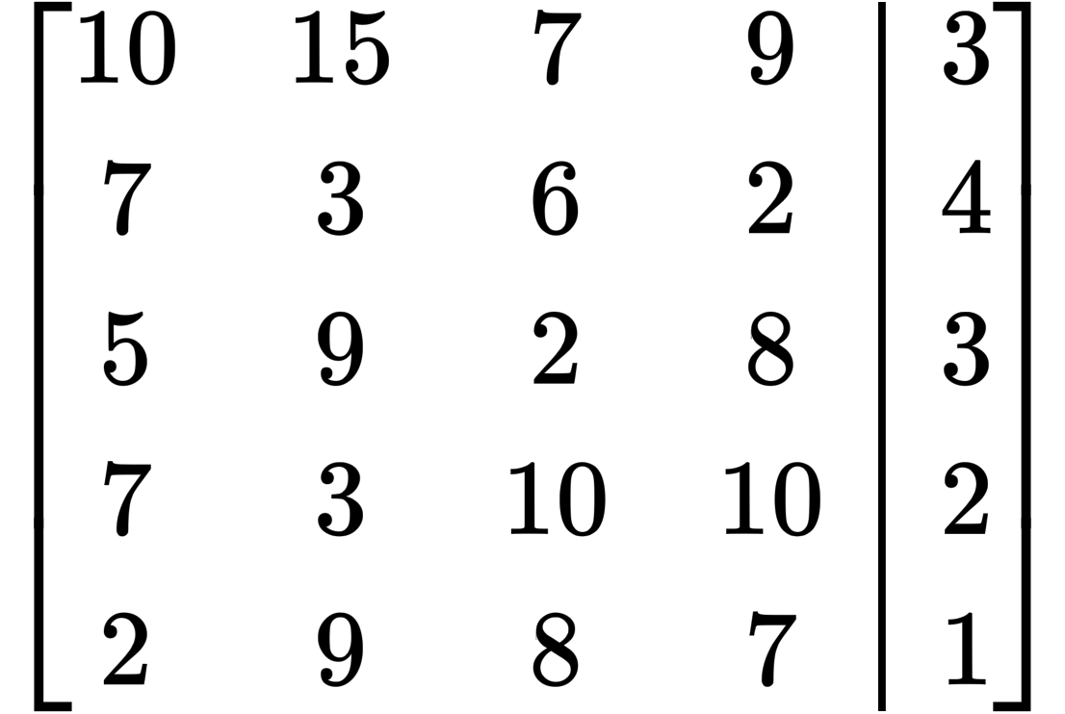
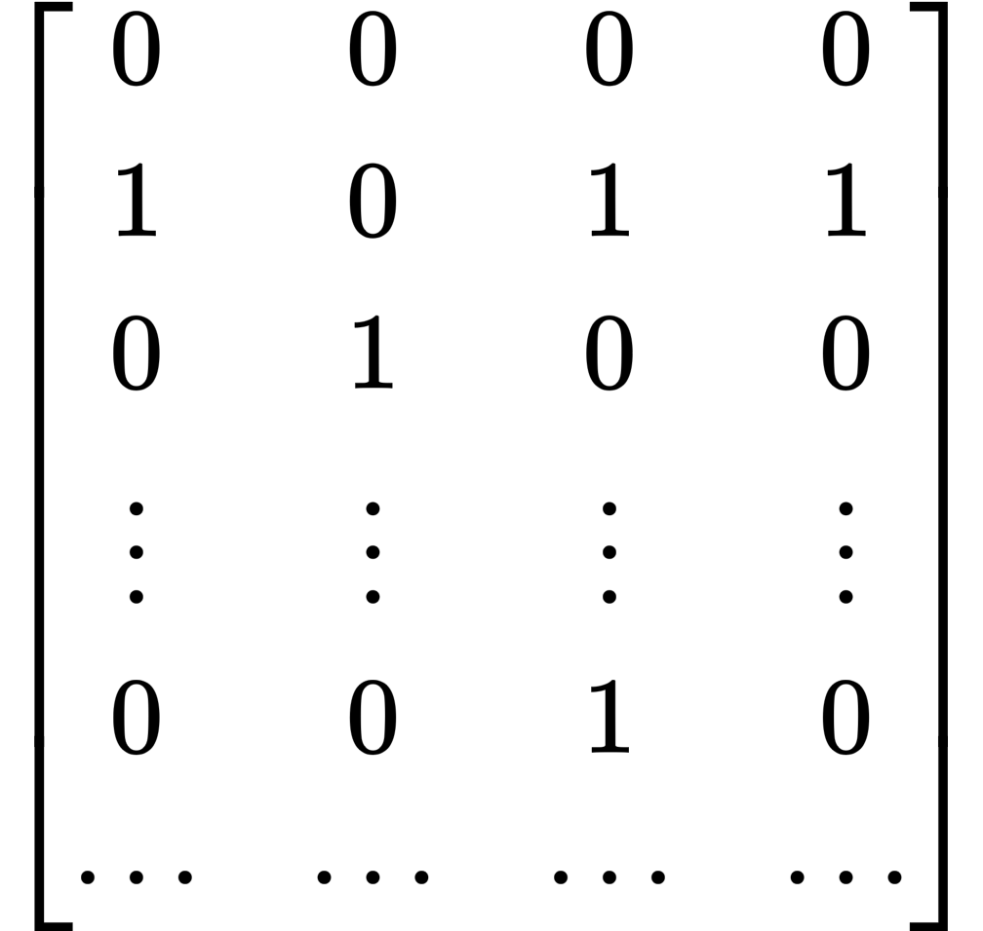
Parking Simulation – Inflow Simulation
①
②
③
④
t1
D1
Inflow Simulation
t2
D2
t3
D3
D4
D5
t7
Inflow
Notes:
All making same choice, therefore all drivers will swarm into the same parking lots (if the choice_utility only use price and distance)

Slide 13




Parking Simulation – Lots Simulation
i-th Parking Lot
①
②
③
④
Lots Simulation
1
2
3
Queue
7
Inflow
Notes:
All making same choice, therefore all drivers will swarm into the same parking lots (if the choice_utility only use price and distance)

Slide 14
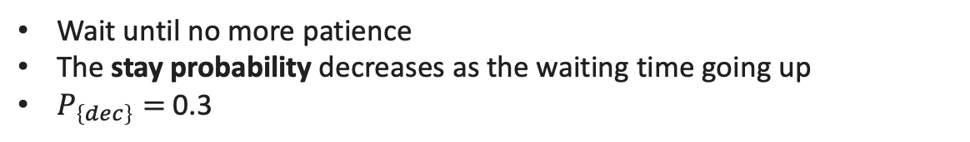
Parking Simulation – Lots Simulation - Queue
Queue
Queue Simulation
Wait until no more patience
The stay probability decreases as the waiting time going up
$P_{\left\{dec\right\}}=$0.3
Notes:
All making same choice, therefore all drivers will swarm into the same parking lots (if the choice_utility only use price and distance)

Slide 15
Parking Simulation – Lots Simulation
Queue
Lots Simulation
Current Battery: 57%
Charging time: 13 mins
Every single car needs charging for a certain amount of time
Charging time
Random
Charging base ± range
Fixed
Notes:
All making same choice, therefore all drivers will swarm into the same parking lots (if the choice_utility only use price and distance)

Slide 16
Simulation Flow
Data Generation
Choice Model
Parking Simulation
Objective Value
Notes:
All making same choice, therefore all drivers will swarm into the same parking lots (if the choice_utility only use price and distance)

Slide 17
Objective Value
System Preference
Objective Value
User Preference
Notes:
All making same choice, therefore all drivers will swarm into the same parking lots (if the choice_utility only use price and distance)

Slide 18
Objective Value
System Preference
Efficiency
Objective Value
User Preference
Utility
Notes:
All making same choice, therefore all drivers will swarm into the same parking lots (if the choice_utility only use price and distance)

Slide 19
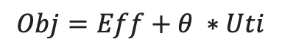
Objective Value
Efficiency
Occupancy rate of chargers
Utility
Neglect the influence of the number of chargers
Only count those who got served
Objective Value
$$Obj=Eff+θ ∗Uti$$
Notes:
All making same choice, therefore all drivers will swarm into the same parking lots (if the choice_utility only use price and distance)

Slide 20
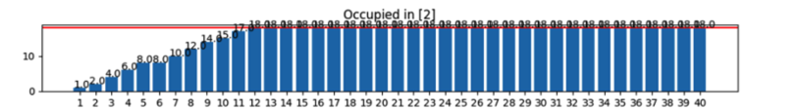

Objective Value
Efficiency
Occupancy rate of chargers
Utility
Neglect the influence of the number of chargers
$$Obj=Eff+θ ∗Uti$$
Objective Value
Blue/Rec!
Notes:
All making same choice, therefore all drivers will swarm into the same parking lots (if the choice_utility only use price and distance)

Slide 21
Global Settings - Offline Observation
Drivers
70
Observation time
40
Available Parking Lots
2
Available chargers
20
Charging Time
Base : 30
Range : ± 5
Scenario
Normal
Game Days
Parameters
Notes:
All making same choice, therefore all drivers will swarm into the same parking lots (if the choice_utility only use price and distance)

Slide 22
Global Settings - Offline Observation
Data Generation
Price
Random, Uniform over base ± range
Distance
Random, Uniform over base ± range
Arrival
Random
Ascending
Choice Model
Alpha
Beta
Gamma
Simulation Model
Staying Probability
Variables
Notes:
All making same choice, therefore all drivers will swarm into the same parking lots (if the choice_utility only use price and distance)

Slide 23
Results – Fixed Situation
General |  | Scenario | Data Generation |  |  |  | Choice Model |  |  | Simulation
Drivers | 70 | Normal |  | Price | Distance | Arrival | Alpha | Beta | Gamma | Stay_Prob | Leave_Ctl | Theta
Ob_Time | 40 |  | Randomness | Fixed | Fixed | Fixed | -0.5 | 1.2 | -2 | 0.3 | FALSE | 0
Park_Lots | 2 |  | Range | 0 | 0 | 0
Chargers | 20 |  | Base | 5 | 60 | Asc
Charging_time | 30±5 |  | Other | 5 | 60 | Asc
Notes:
All making same choice, therefore all drivers will swarm into the same parking lots (if the choice_utility only use price and distance)

Slide 24
Results
Notes:
All making same choice, therefore all drivers will swarm into the same parking lots (if the choice_utility only use price and distance)

Slide 25
Results
Notes:
All making same choice, therefore all drivers will swarm into the same parking lots (if the choice_utility only use price and distance)

Slide 26
Thank you!

